Slide 1
Global and Local Alignment
Dr. Muhammad Tahir
Assistant Professor
COMSATS University Islamabad,
Attock Campus

Slide 2
Sequence Alignment
Sequence alignment is a way of arranging the sequences of DNA, RNA, or protein to identify regions of similarity.
That may be a consequence of functional, structural, or evolutionary relationships between the sequences.
It is an important first step toward structural and functional analysis of newly determined sequences.
The sequence alignment is made between a known sequence and unknown sequence or between two unknown sequences.
The known sequence is called reference sequence.
The unknown sequence is called query sequence.
Types of Sequence Alignment
Global Alignment
Local Alignment

Slide 3
Alignment methods
Introduction to global and local sequence alignment methods
Global : Needleman-Wunch
Local : Smith-Waterman
Global alignment program is based on Needleman-Wunsch algorithm and local alignment on Smith-Waterman.
Both algorithms are derivates from the basic dynamic programming algorithm.
These two dynamic programming alignment algorithm are guaranteed to give OPTIMAL alignments
🡺 But O(m*n) quadratic

Slide 4
Alignment Methods
Learning objectives:
Understand the principles behind the Needleman-Wunsch method of alignment.
Understand how software operates to optimally align two sequences

Slide 5
GLOBAL ALIGNMENT
Global alignment program is based on Needleman-Wunsch algorithm
In global alignment, two sequences to be aligned are assumed to be generally similar over their entire length.
Alignment is carried out from beginning to end of both sequences to find the best possible alignment across the entire length between the two sequences.
Input: treat the two sequences as potentially equivalent
Goal: identify conserved regions and differences
Applications:
- Comparing two genes with same function (in human vs. mouse).
- Comparing two proteins with similar function.

Slide 6
Needleman Wunsch Sequence Alignment
The Needleman–Wunsch algorithm performs a global alignment on two sequences.
It is commonly used in bioinformatics to align protein or nucleotide sequences.
The algorithm was proposed in 1970 by Saul Needleman and Christian Wunsch in their paper A general method applicable to the search for similarities in the amino acid sequence of two proteins, J Mol Biol. 48(3):443-53.
The Needleman–Wunsch algorithm is an example of dynamic programming, and was the first application of dynamic programming to biological sequence comparison.

Slide 7
Needleman-Wunsch Method (1970)
Output:
An alignment of two sequences is represented by three lines
The first line shows the first sequence
The third line shows the second sequence.
The second line has a row of symbols.
The symbol is a vertical bar wherever characters in
the two sequences match, and a space wherever they do not match.
Dots may be inserted in either sequence to represent gaps.

Slide 8
Needleman-Wunsch Method (cont. 1)
For example, the two hypothetical sequences
Seq 1: abcdefghajklm
Seq 2: abbdhijk
could be aligned like this
abcdefghajklm
|| | | ||
abbd...hijk
As shown, there are 6 matches,
2 mismatches, and one gap of length 3.

Slide 9
Needleman-Wunsch Method (cont. 2)
The alignment is scored according to a payoff matrix
$payoff = { match => $match,
mismatch => $mismatch,
gap_open => $gap_open,
gap_extend => $gap_extend };
For correct operation, match must be positive,
and the other entries must be negative.

Slide 10
Needleman-Wunsch Method (cont. 3)
Example
Given the payoff matrix
$payoff = { match => 4,
mismatch => -3,
gap_open => -2,
gap_extend => -1 };

Slide 11
Needleman-Wunsch Method (cont. 4)
The sequences
abcdefghajklm
abbdhijk
are aligned and scored like this
a b c d e f g h a j k l m
| | | | | |
a b b d . . . h i j k
match 4 4 4 4 4 4
mismatch -3 -3
gap_open -2
gap_extend -1-1-1
for a total score of 24-6-2-3 = 13.

Slide 12
Needleman-Wunsch Method (cont. 5)
The algorithm guarantees that no other
alignment of these two sequences has a
higher score under this payoff matrix.

Slide 13
Needleman-Wunsch Method (cont. 6) Dynamic Programming
Potential difficulty.
How does one come up with the optimal alignment in the first place?
We now introduce the concept of dynamic programming (DP).
DP can be applied to a large search space that can be structured
into a succession of stages such that:
The initial stage contains trivial solutions to sub-problems
Each partial solution in a later stage can be calculated by recurring on only a fixed number of partial solutions in an earlier stage.
The final stage contains the overall solution.

Slide 14
Dynamic Programming Method
It was introduced by Richard Bellman in 1940.
The word programming here denotes finding an acceptable plan of action not computer programming.
It is useful in aligning nucleotide sequence of DNA and amino acid sequence of proteins coded by that DNA.
Dynamic programming is a three steps process that involves :
Breaking of the problem into small sub problems.
Solving sub problems using recursive methods.
Construction of optimal solutions for original problem using the optimal solution

Slide 15
Three steps in Dynamic Programming
1. Initialization
2 Matrix fill or scoring
3. Traceback and alignment

Slide 16
Two sequences will be aligned.
GAATTCAGTTA (sequence #1)
GGATCGA (sequence #2)
A simple scoring scheme will be used
S_{i,j} = 1 if the residue at position I of sequence #1 is the same as
the residue at position j of the sequence #2 (called match score)
S_{i,j} = 0 for mismatch score
w = gap penalty

Slide 17
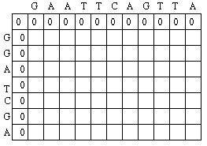
Initialization step: Create Matrix with M + 1 columns
and N + 1 rows. First row and column filled with 0.

Slide 18
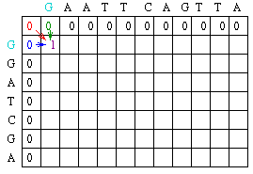
Matrix fill step: Each position M_{i,j} is defined to be the
MAXIMUM score at position i,j (where i= row and j=column)
M_{i,j} = MAXIMUM [M_{i-1, j-1} + s_{i,,j} (match or mismatch in the diagonal), M_{i, j-1} + w (gap in sequence #1), M_{i-1, j} + w (gap in sequence #2)]

Slide 19
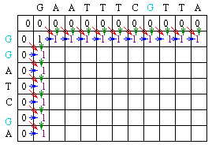
Fill in rest of row 1 and column 1

Slide 20
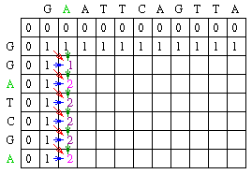
Fill in column 2

Slide 21
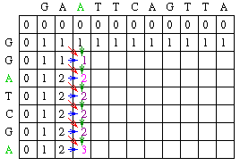
Fill in column 3

Slide 22
Column 3 with answers

Slide 23
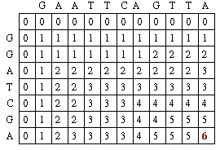
Fill in rest of matrix with answers

Slide 24
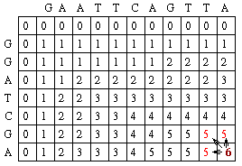
Traceback step:
Position at current cell and look at direct predecessors
Seq#1 A
|
Seq#2 A

Slide 25
Traceback step:
Position at current cell and look at direct predecessors
Seq#1 G A A T T C A G T T A
| | | | | |
Seq#2 G G A T - C - G - - A

Slide 26
Needleman-Wunsch Method Dynamic Programming
The problem with Needleman-Wunsch is the amount of
processor memory resources it requires. Because of this
it is not favored for practical use, despite the guarantee of an
optimal alignment. The other difficulty is that the concept of
global alignment is not used in pairwise sequence comparison
searches.
Visualization:
http://rna.informatik.uni-freiburg.de/Teaching/

Slide 27
Needleman-Wunsch Method Typical output file
Global: HBA_HUMAN vs HBB_HUMAN
Score: 290.50
HBA_HUMAN 1 VLSPADKTNVKAAWGKVGAHAGEYGAEALERMFLSFPTTKTYFP 44
|:| :|: | | |||| : | | ||| |: : :| |: :|
HBB_HUMAN 1 VHLTPEEKSAVTALWGKV..NVDEVGGEALGRLLVVYPWTQRFFE 43
HBA_HUMAN 45 HF.DLS.....HGSAQVKGHGKKVADALTNAVAHVDDMPNALSAL 83
| ||| |: :|| ||||| | :: :||:|:: : |
HBB_HUMAN 44 SFGDLSTPDAVMGNPKVKAHGKKVLGAFSDGLAHLDNLKGTFATL 88
HBA_HUMAN 84 SDLHAHKLRVDPVNFKLLSHCLLVTLAAHLPAEFTPAVHASLDKF 128
|:|| || ||| ||:|| : |: || | |||| | |: |
HBB_HUMAN 89 SELHCDKLHVDPENFRLLGNVLVCVLAHHFGKEFTPPVQAAYQKV 133
HBA_HUMAN 129 LASVSTVLTSKYR 141
:| |: | ||
HBB_HUMAN 134 VAGVANALAHKYH 146
%id = 45.32 %similarity = 63.31
Overall %id = 43.15; Overall %similarity = 60.27

